Slide 1
Passing Stones Problem
By Sunwoo Yim, Vinit Ranjan, Peter Cheng, Aaron Sartin

Slide 2
Problem
In a graph, all stones will start on one vertex.
If the number of stones on any vertex is greater than or equal to the degree of the vertex, then the vertex will pass along one stone to each adjacent vertex for the next step.
Used a program made by Aaron.

Slide 3
Definitions
s- number of initial stones
n- number of vertices on graph
v_i- vertex that is given the initial s stones
step- an iteration from one state of stones to another
Saturation- when the number of stones on each vertex is equal to the degree of the vertex

Slide 4
Definitions
Oversaturated- when a vertex contains more stones than the degree of said vertex
n-state equilibrium- the number of different steps required to reach the last step of the first equilibrium
Endpoint of path- the 2 vertices with degree 1

Slide 5
General Graphs
Every graph with any initial concentration of stones requires a finite number of steps to reach any equilibrium.
In a disconnected graph, the sub-graph that does not contain v_i will have zero stones in the equilibrium.

Slide 6
Path Graphs
If the number of stones is less than 2n-2, then the path graph will always have a two-step equilibrium state.
If the number of stones is greater than or equal to 2n-2, then the path graph will always have a saturated one-step equilibrium state.

Slide 7
Path Graphs
Found upper bound of the number of steps required to reach equilibrium when the number of stones is greater than or equal to 2n.
0
7
0
0
1
3
2
1

Slide 8



5 Stone 5 Vertices Graph

Slide 9
Cycle Graphs
Every cycle graph with less than 2n stones has a two-step equilibrium.
Cycle graphs with 2n stones ends in all vertices with 2 stones.
Any cycle graph with more than 2n stones will have a one-step equilibrium.

Slide 10
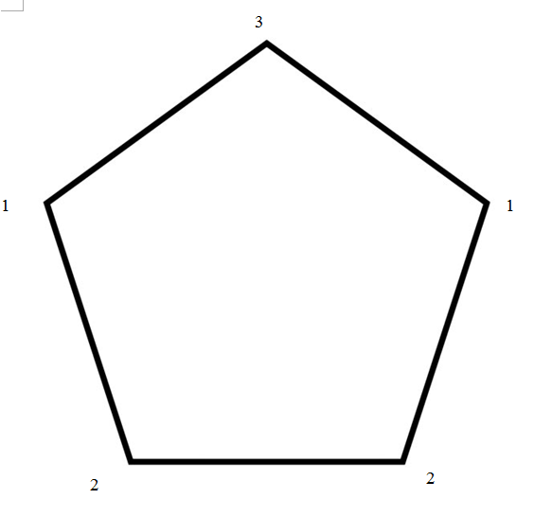
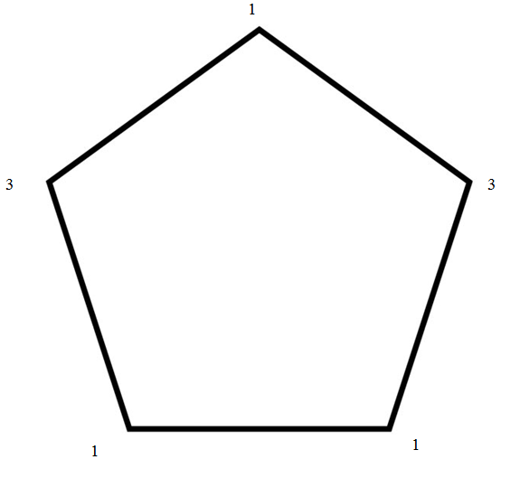
9 Stones Pentagon Example

Slide 11
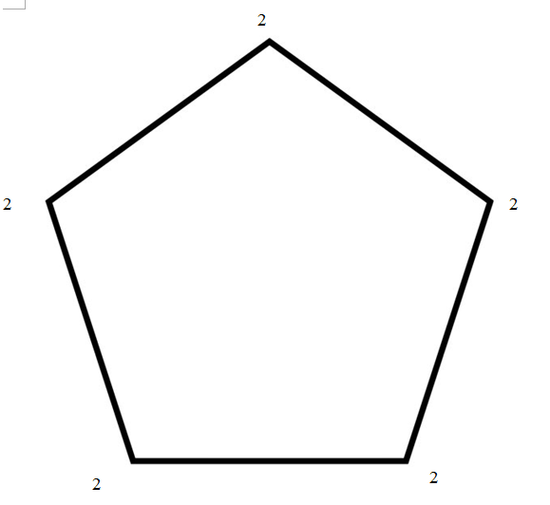
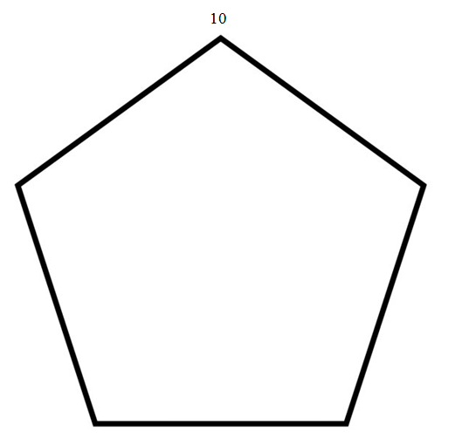
10 Stones Pentagon Example

Slide 12
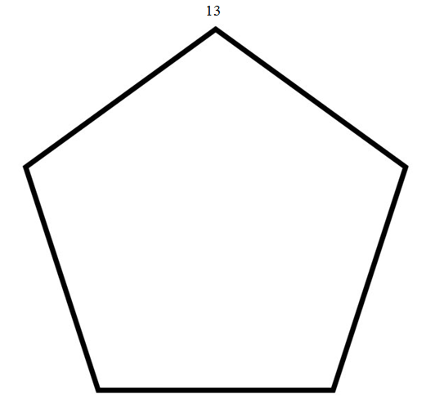
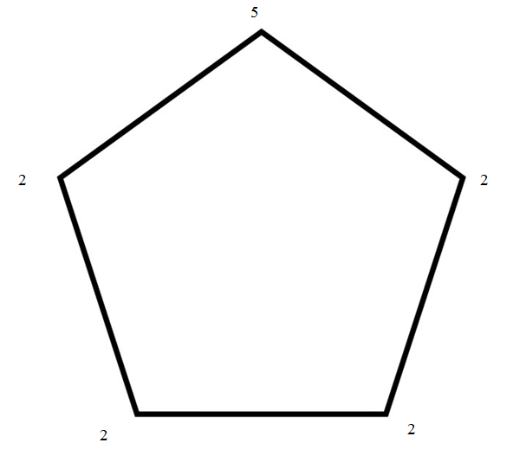
13 Stones Pentagon Example

Slide 13
Complete Graphs
If the number of stones is greater than or equal to n(n-1), the graph will always have a saturated one-step equilibrium state.
If the number of stones is greater than or equal to n-1 and less than n(n-1), then the graph will always have a two-state equilibrium that will start after n-1 steps.

Slide 14
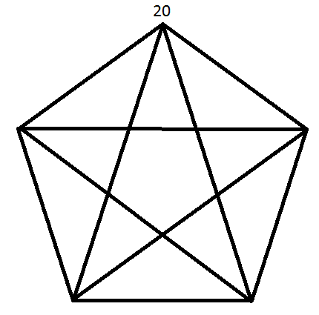
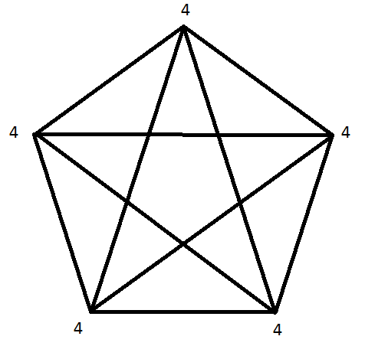
20 Stone K5 Example

Slide 15
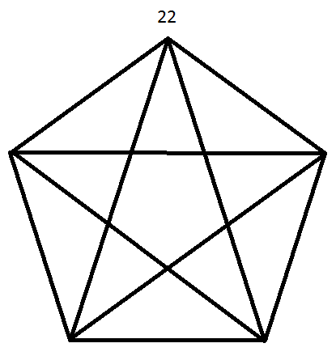
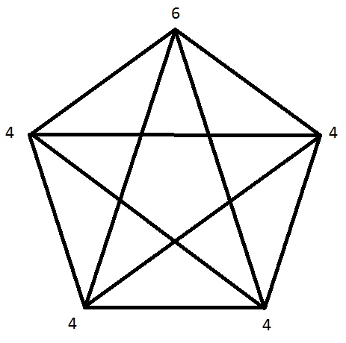
22 Stones K5 Example

